Slide 1

Please leave a tip
15%
18%
25%
NO TIP
CUSTOM

Slide 2

*点击no tip跳到这个界面*
BAD TIP

Slide 3
*点击custom tip跳到这个界面*
CUSTOM TIP
99%

Slide 4
*点击99%跳到这个界面*
THANK YOU

Slide 5

*点击初始界面笑脸跳到这个界面*
15%
18%
25%
NO TIP
CUSTOM

Slide 6

*点击图片往后跳*
15%
18%
25%
NO TIP
CUSTOM

Slide 7

*点击图片往后跳*
15%
18%
25%
NO TIP
CUSTOM

Slide 8
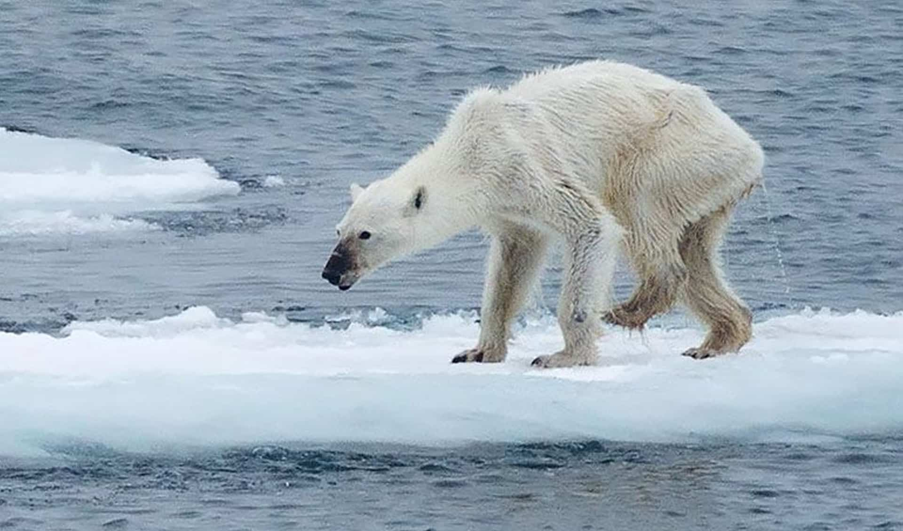
*点击图片往后跳*
15%
18%
25%
NO TIP
CUSTOM

